Slide 1
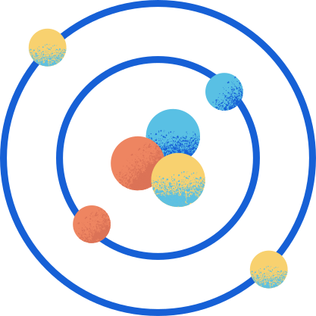
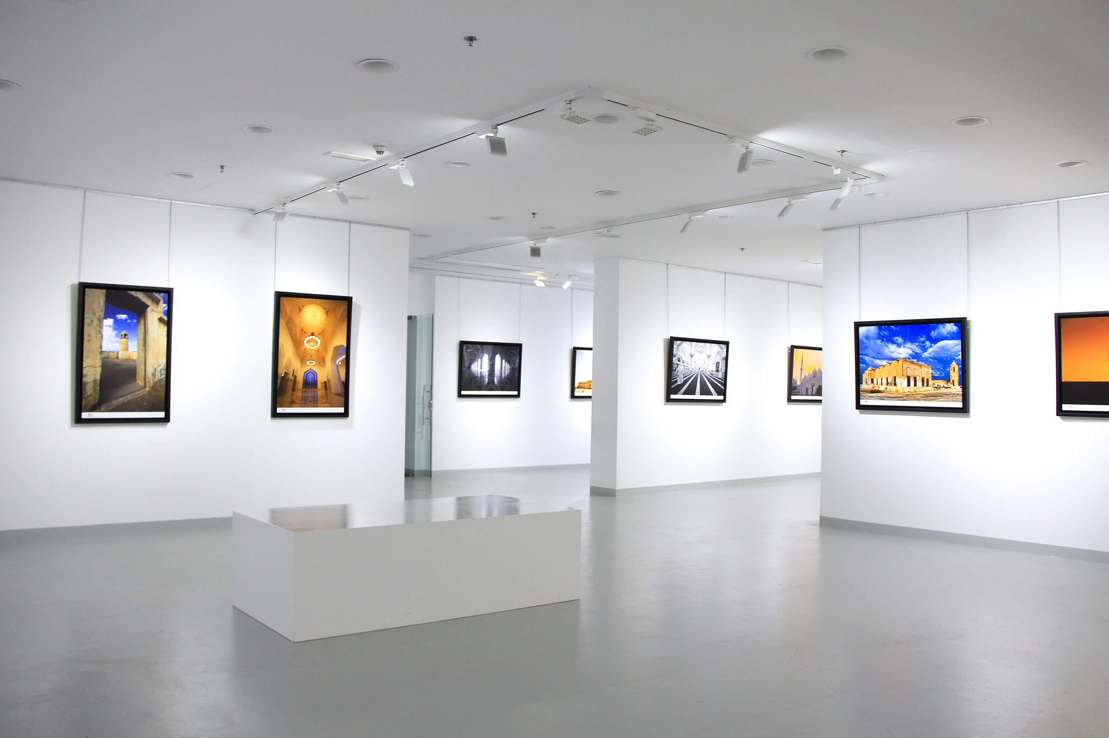

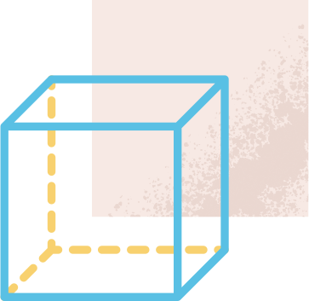
ART GALLERY PROBLEM
Team 15

Slide 2
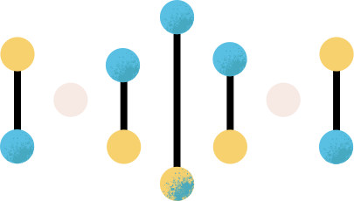
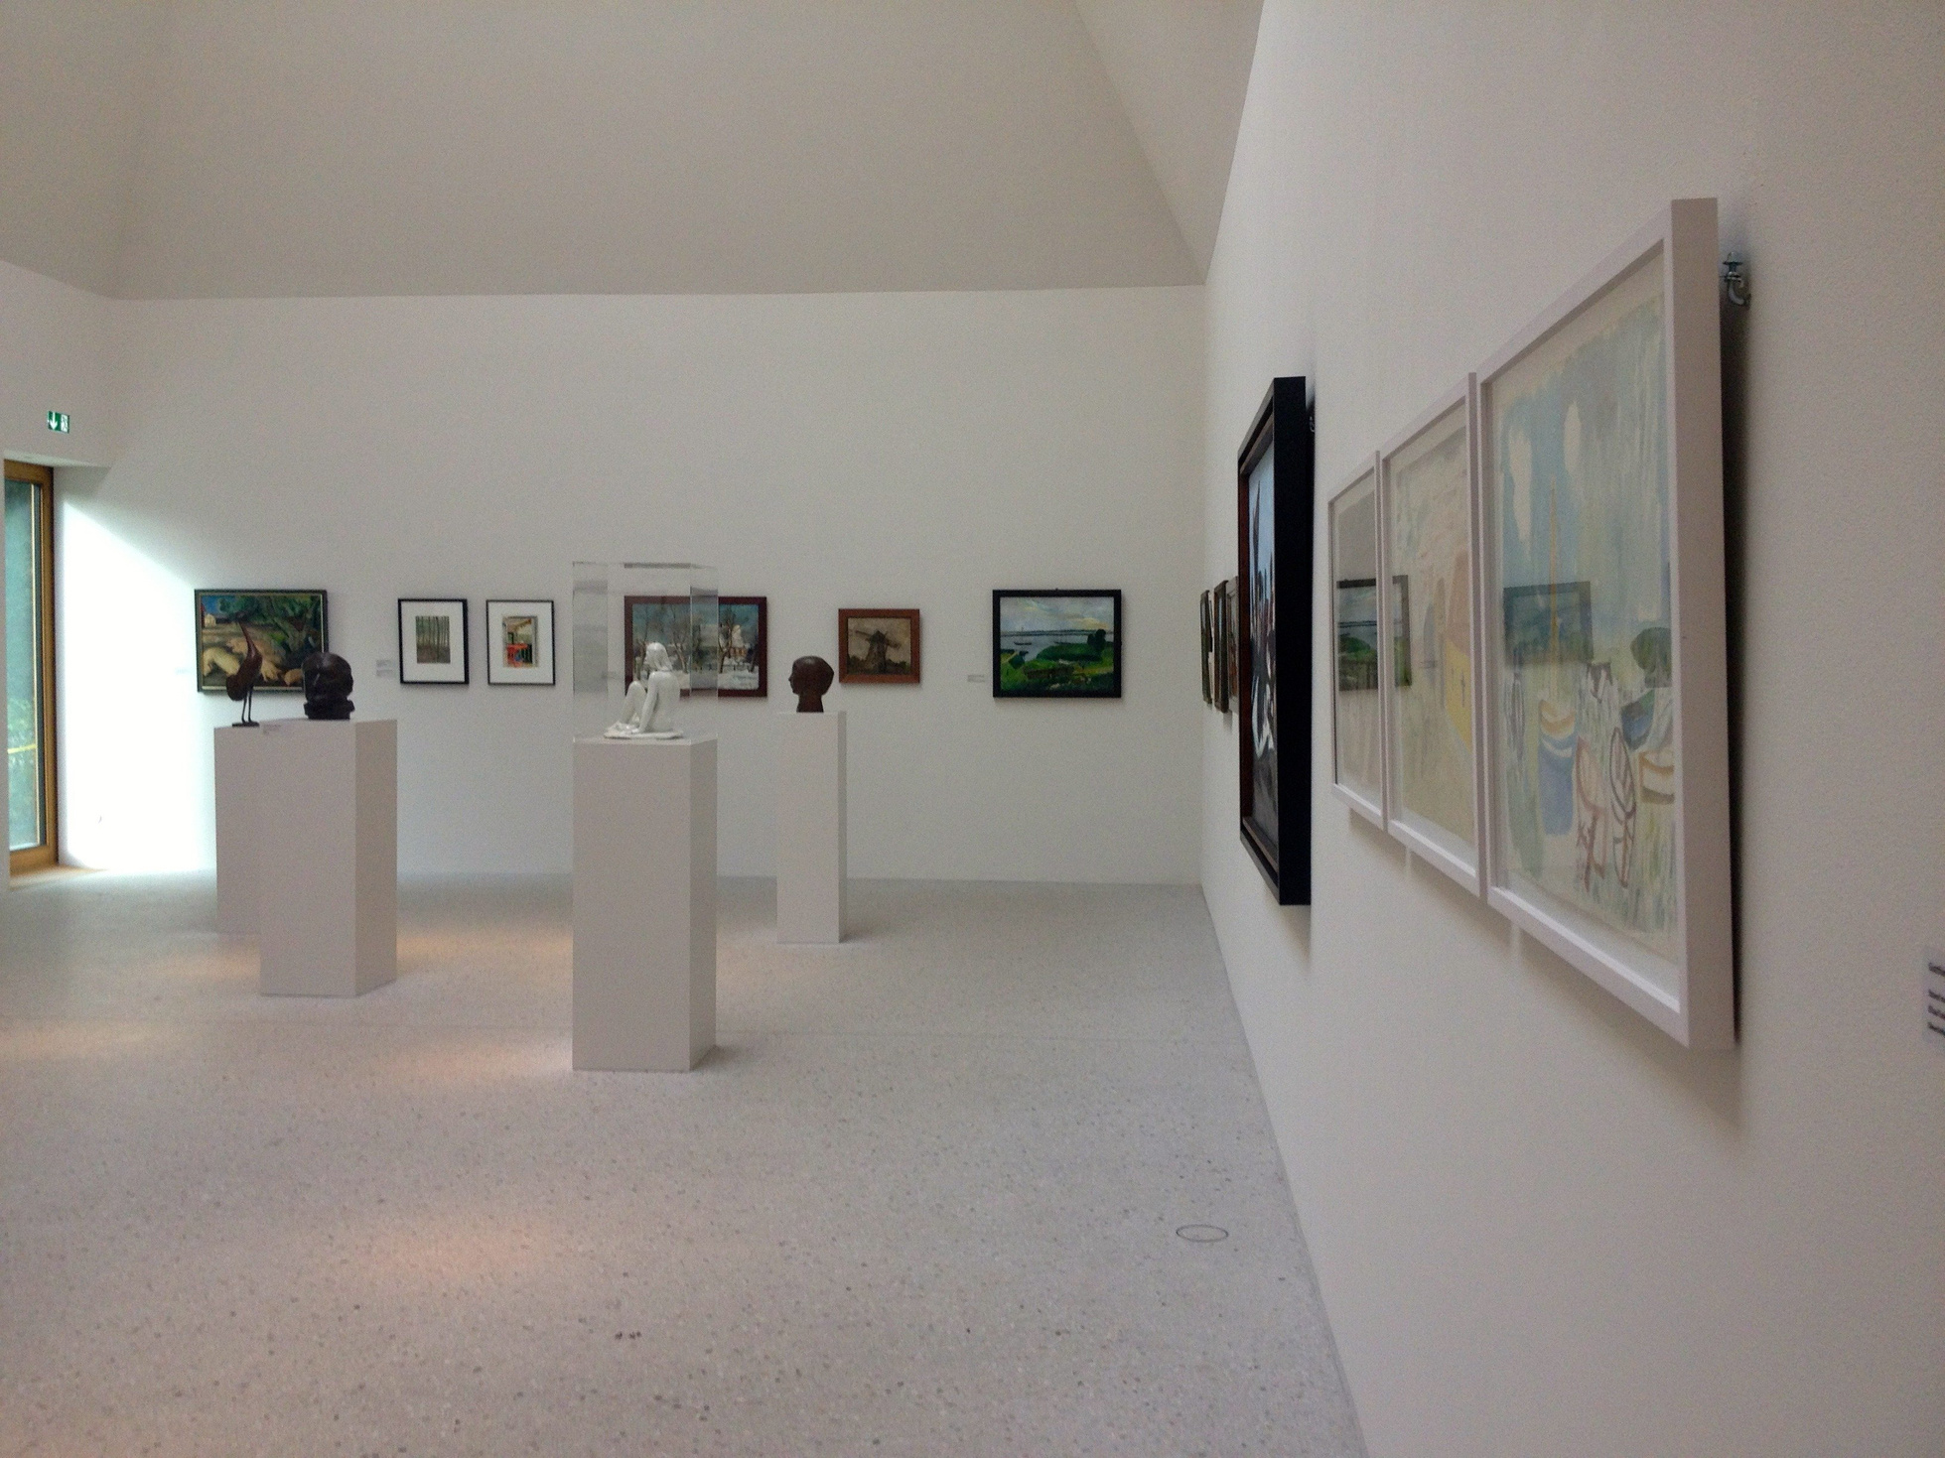
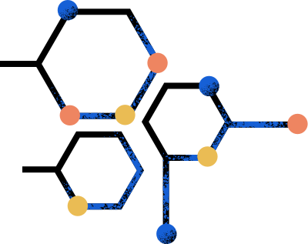
PROBLEM STATEMENT
"Art galleries often have odd-shaped rooms. Can we always find a way to place the fewest possible guards to watch over the whole gallery?"

Slide 3

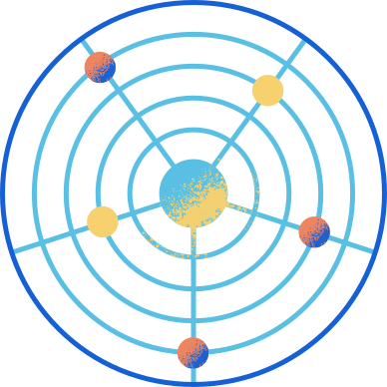
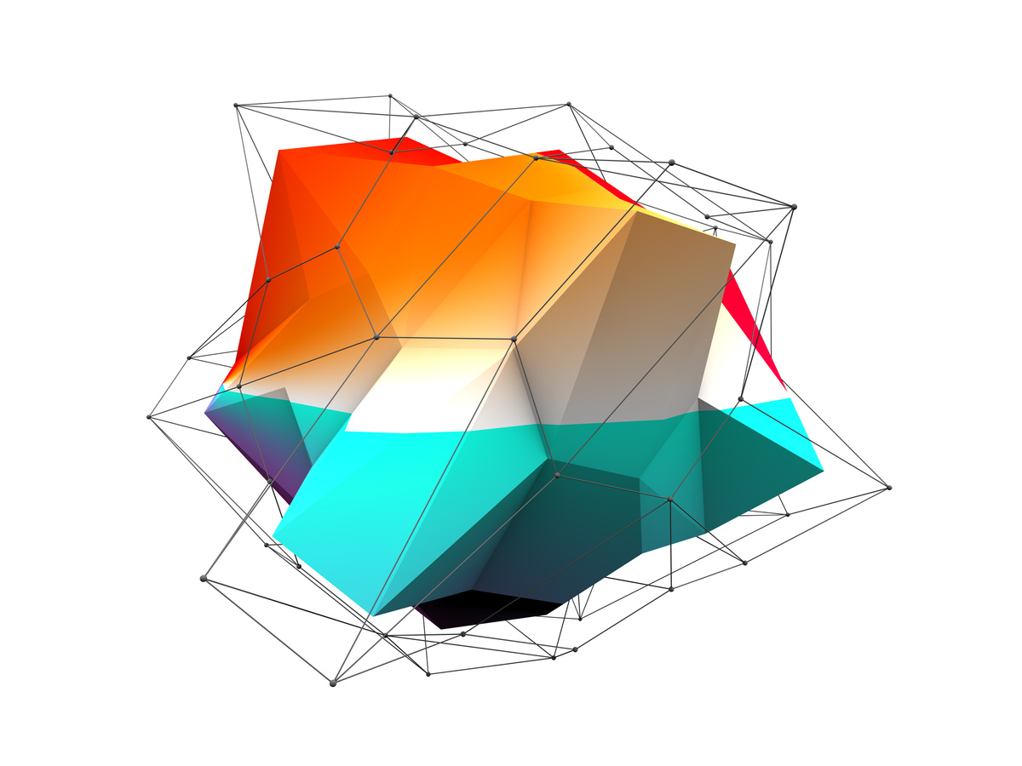
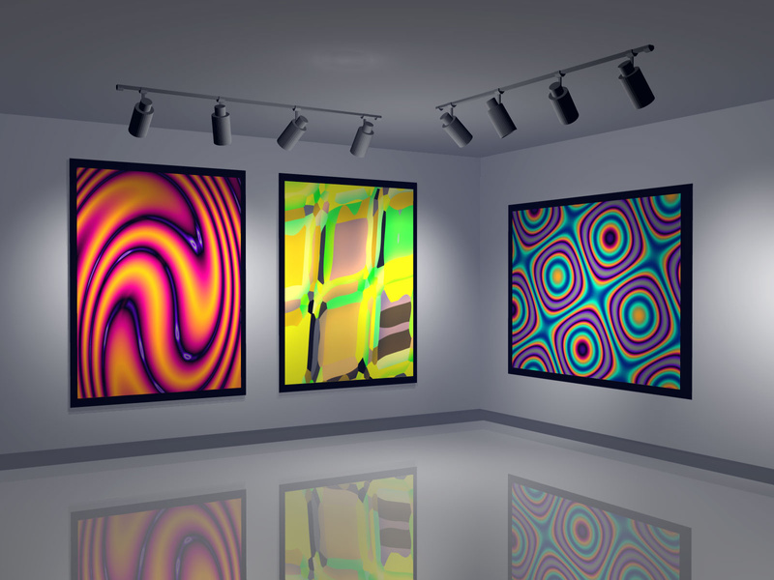

ASSUMING ART GALLERY AS A POLYGON
The Concept of Polygon
Why use Polygons?
A geometric shape with at least three line segments that are connected, closed, and do not overlap.
Galleries naturally have polygonal shapes, which makes this a useful approach

Slide 4
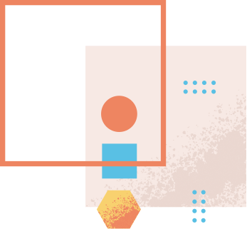
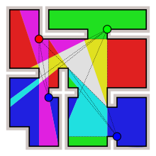
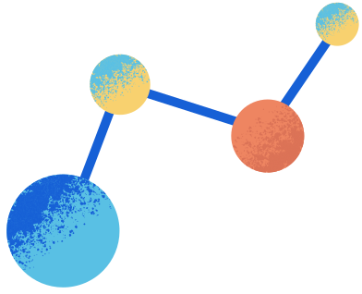
EXHAUSTIVE METHOD: TRIAL AND ERROR
What is Exhaustive Method?
This approach involves placing a guard at a random location and then verifying whether the placement guarantees complete coverage or not. In other words, it is a trial and error method where the guard's placement is tested randomly until a satisfactory outcome is achieved.
Advantages and Disadvantages
This method is guaranteed to work, but It is time-consuming, exhaustive and inefficient for large polygons.

Slide 5
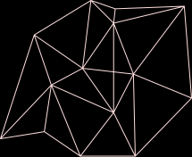
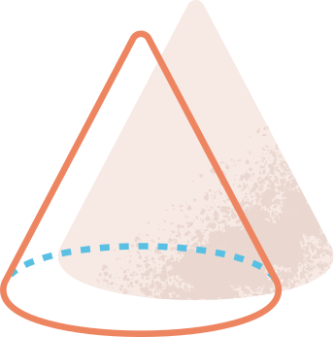
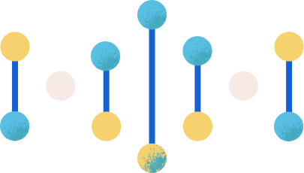
TRIANGULATION METHOD
How does Triangulation Work?
Proof Using Graphs
The Triangulation Method involves dividing the gallery into triangles, and using the edges of the triangles to observe the gallery.
The proof for this method can be illustrated using graphs, where each vertex represents a room in the gallery, and each edge represents the line of sight of a guard. The guards should be positioned at each vertex of the triangles for complete coverage.

Slide 6

SIMPLIFYING THE PROBLEM
Observation
Triangles are easy to guard
Partition the polygon into triangles and guard every triangle
Idea

Slide 7


Slide 8
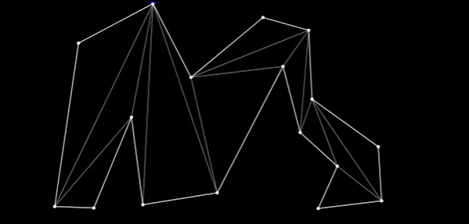

POLYGON CAN BE GUARDED WITH N-2 GUARDS

Slide 9
POLYGON CAN BE GUARDED WITH APPROXIMATELY N/2 GUARDS

Slide 10
EVEN FEWER

Slide 11
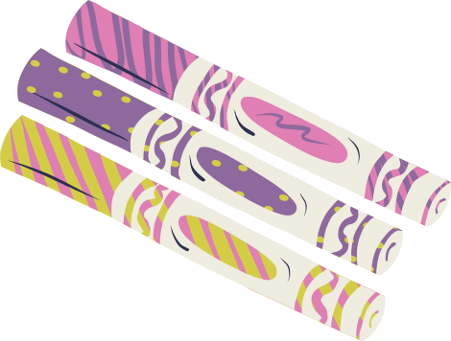



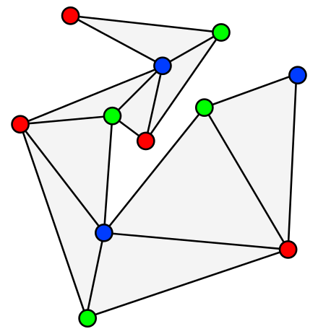
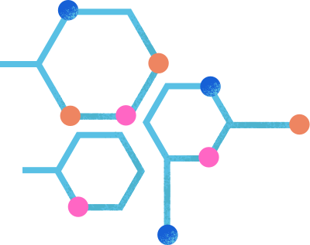
Theorem
[n//3] guards are sometimes necessary and always sufficient to guard a simple polygon with n vertices

Slide 12
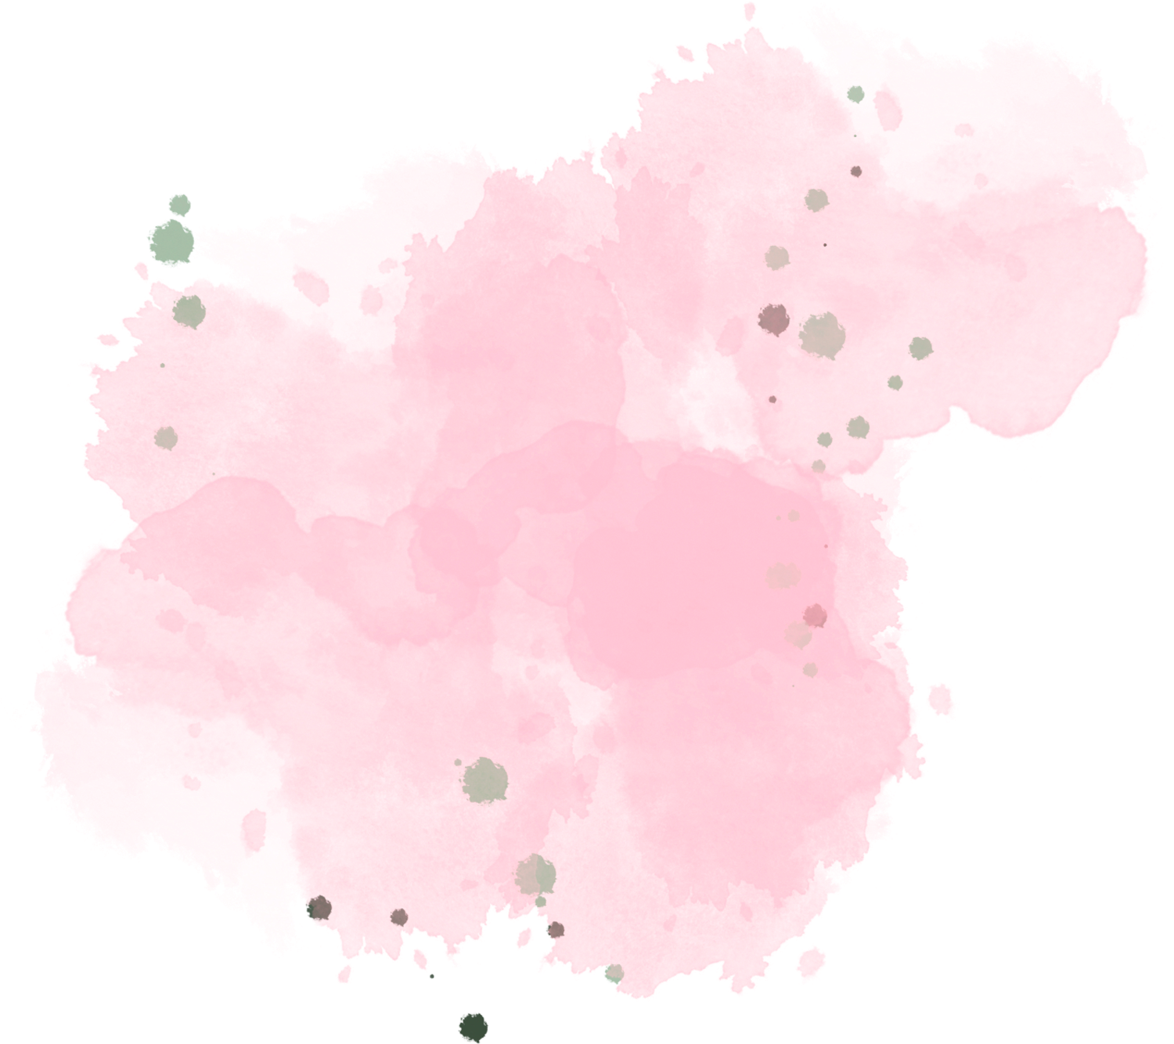


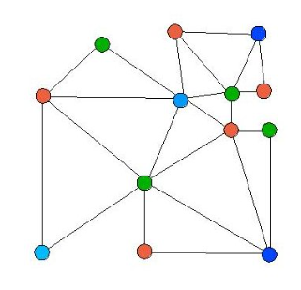

3-COLORATION METHOD
Taking Triangulation method a step further
Every triangulated graph is 3-coloarable
First we will be coloring the three vertices of the each triangle in the triangulated polygon. We can use red, green and blue for each vertex such that no two adjacent vertices contain same color and every segmented triangle contain all three colored vertices

Slide 13
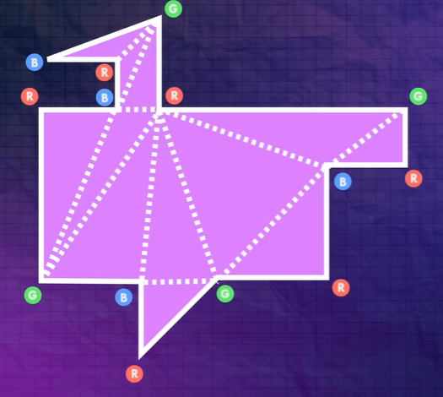
THE PROOF!
Considering an arbitrary polygon and triangulating it.
Coloring the three vertices of triangle with red green and blue by graph coloring method.
The number of vertices of each color in this case are;
RED --> 6
GREEN --> 4
BLUE --> 4

Slide 14
THE PROOF!
4. Since every triangle has all three vertices than if we choose the color with minimum number of vertices the whole polygon is still getting covered.
5. We will be placing the guards at the selected colored vertices. In this case we can either choose GREEN or BLUE.
OBSERVATION: The total number of vertices of polygon are 14 and in this case 14//3 is 4, which is same as the number of selected colored vertices

Slide 15
COMPARISON
TRIANGULATION
3- COLORATION
Triangulation can simplify the problem of guarding a polygonal gallery by reducing it to smaller triangles.
It can be effective for certain shapes with well-defined features, but more complex for irregular or complex shapes.
It can also result in redundant guard coverage, increasing the number of guards needed.
The 3-coloration method ensures no two adjacent vertices have the same color, guaranteeing every segment of the gallery is covered by a guard of a different uniform color.
It can help identify the minimum number of guards needed by analyzing the placement of the guards within each triangle and minimizing overlapping coverage.
Its limitation is the number of available colors, which may not be enough for complex or irregularly shaped galleries.

Slide 16
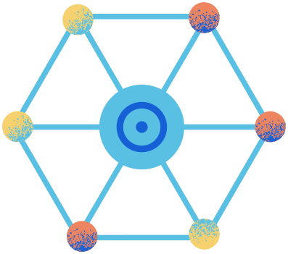
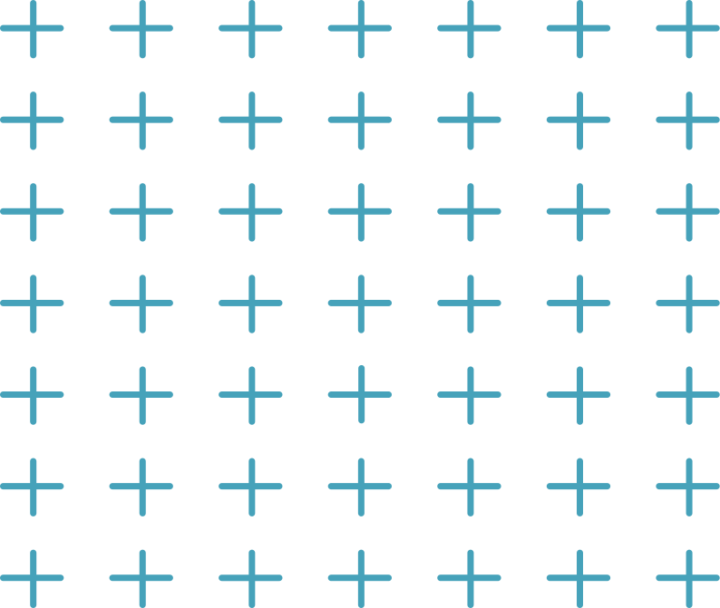


APPLICATIONS
Robotics and autonomous systems
Surveillance and security
Visual arts
The art gallery problem is relevant in the development of autonomous systems, such as robots that need to navigate through a space while avoiding obstacles.
The art gallery problem can be used to determine the minimum number of security guards or cameras needed to cover an area, such as a museum or a building.
The art gallery problem has inspired artists to create art installations and exhibitions that explore the concept of space and perception.

Slide 17



THANK YOU

